Slide 1
How to:
Install the Droplet/Virtual Printer Application
Notes:
Notes: Check online access prior to starting the presentation
Time: 1 minute
Script: PNE introduces self

Slide 2
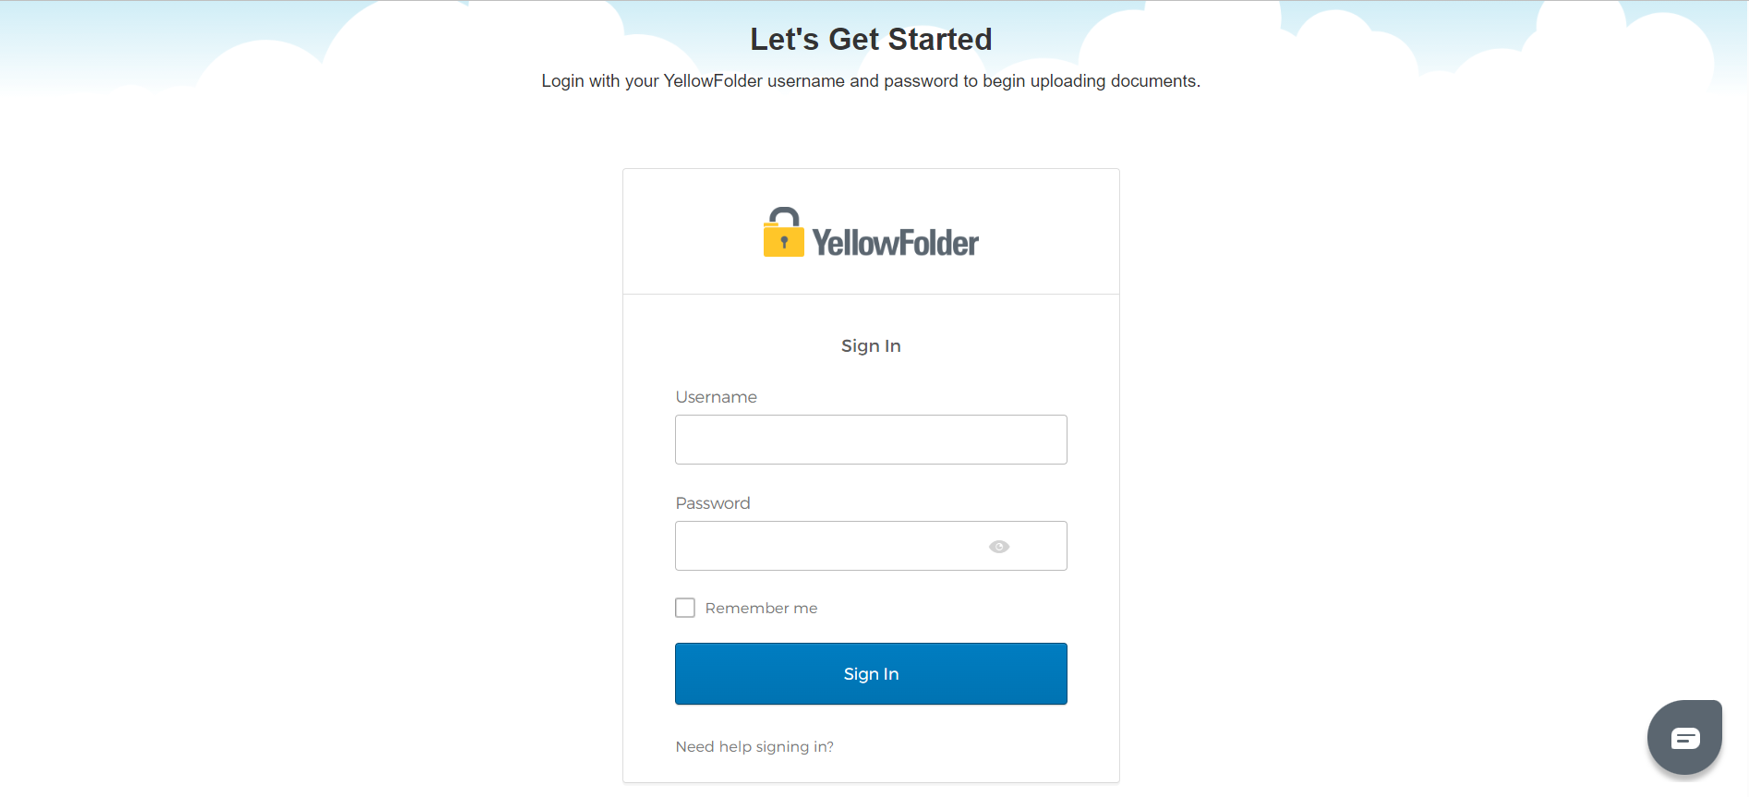
Step 1: Login to YellowFolder

Slide 3
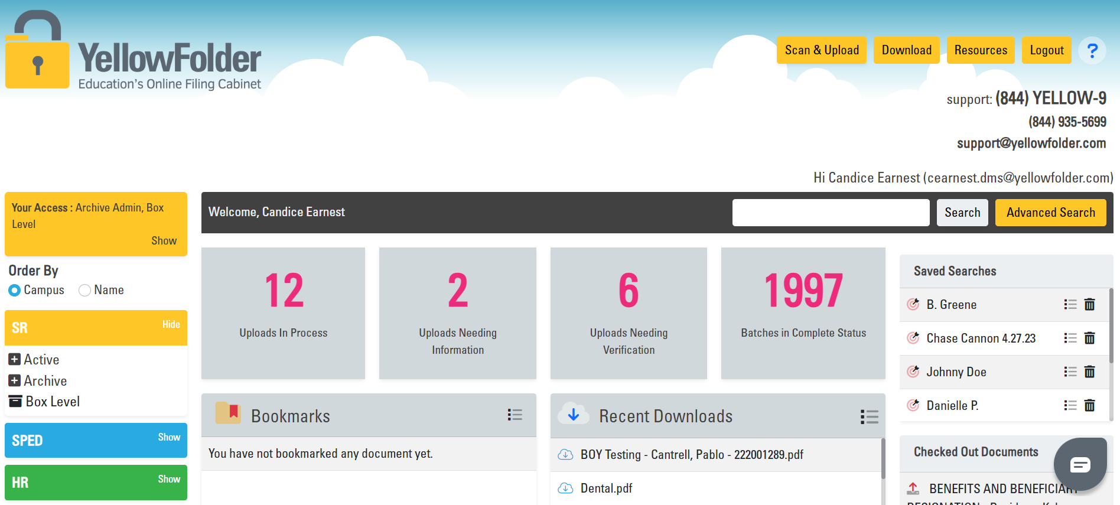
Step 2: Click “Download”

Slide 4
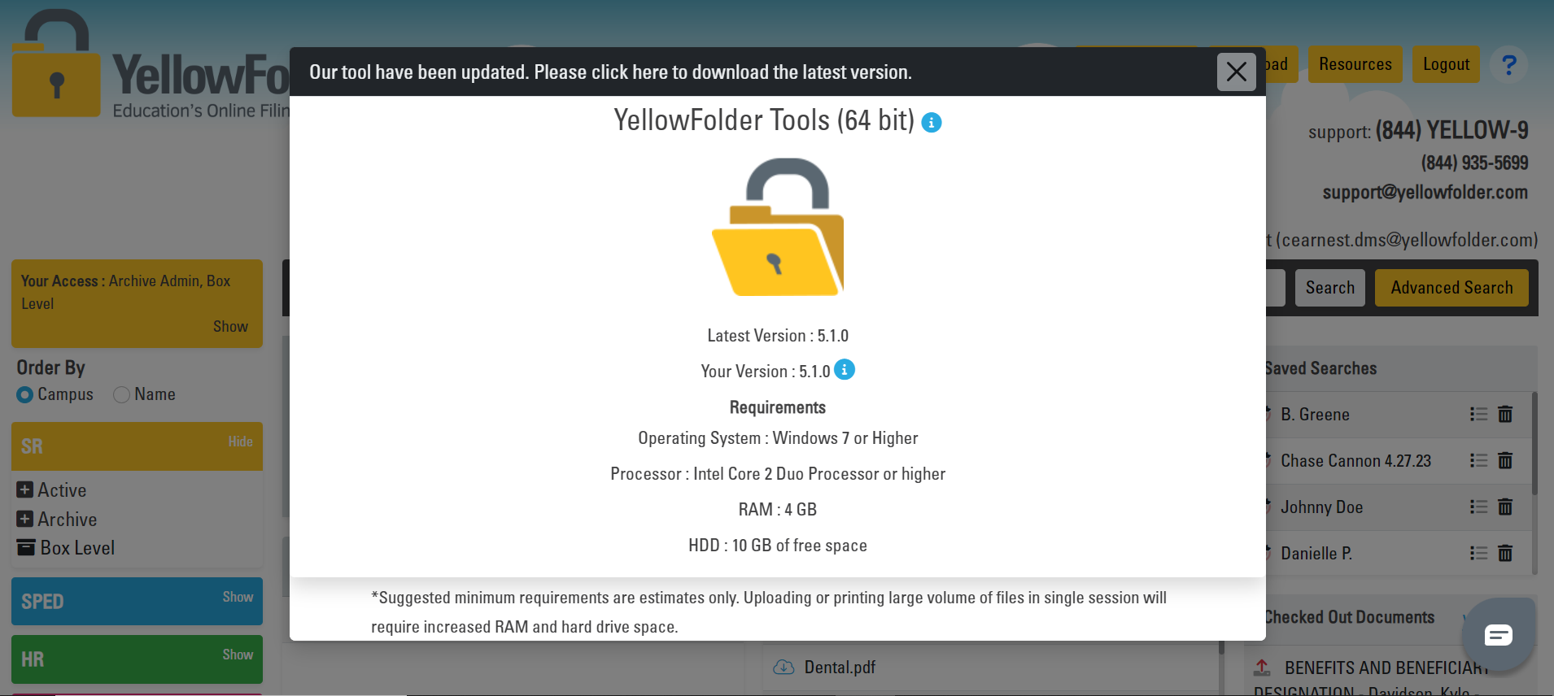
Step 3: Click Lock

Slide 5
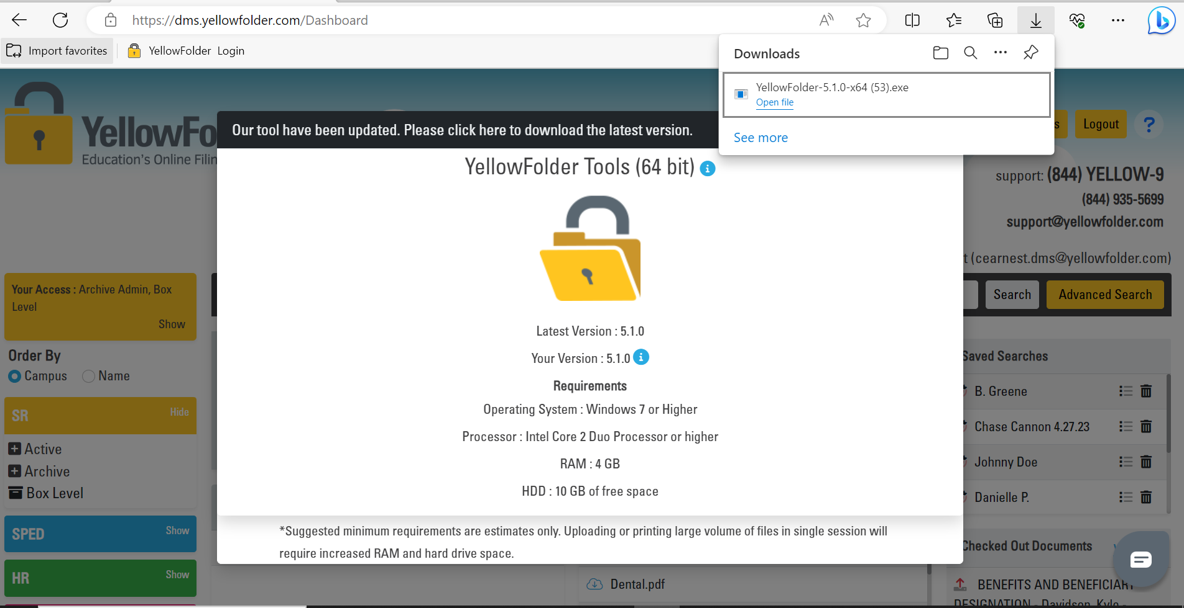
Step 4: Click Installer-Follow Prompts*
*If directions prompt you to enter a username/password, please contact your DISTRICT technology team for credentials (not YellowFolder).

Slide 6
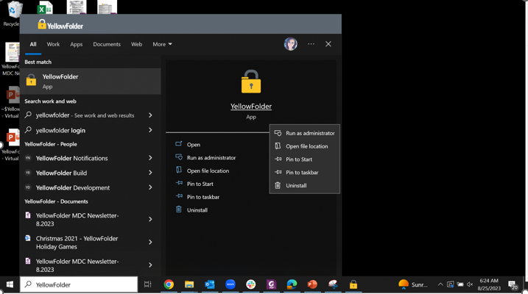
Step 5: Locate/Launch/Pin the Application
5a. Type YellowFolder in your device search bar to locate the application and open/launch.
5b. It is recommended that you pin the application to your taskbar for easy access.

Slide 7
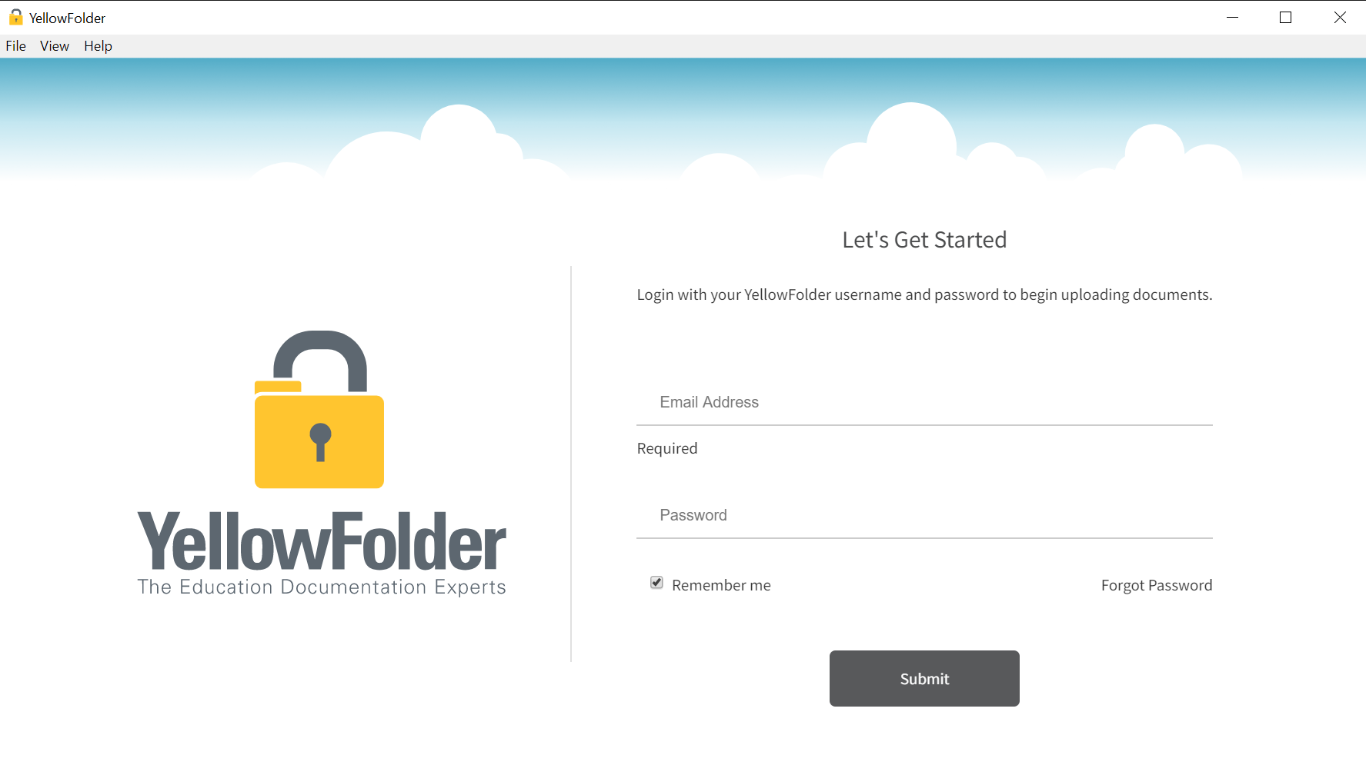
Step 6: Login to the Application*
*Your upload application username and password are the same as your YellowFolder cloud-based account credentials.

Slide 8
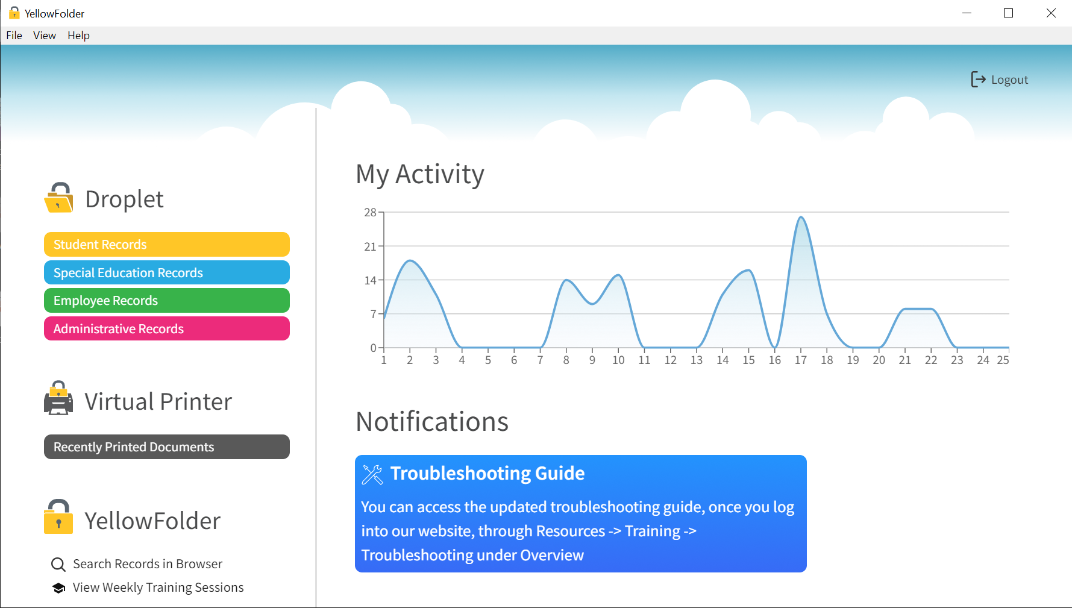
Step 7: Upload Records*
*For more information on how to upload records using either the Virtual Printer or the Droplet:
Contact your PNE to receive 1-1 training on any of the system features.
Click here to sign up for a live weekly session on a specific topic that will be individualize for you and scheduled at your convenience.
Click here to sign in and access training PowerPoints, videos, courses, etc. in our Resources section.

Slide 9
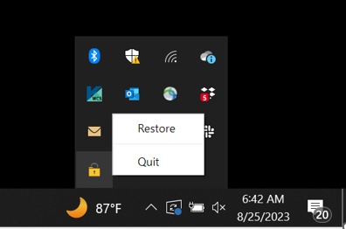
Step 8 (if needed): Restoring the Application*
*If you close or “x” out of the application throughout the day, you will need to “Restore” the application from your hidden icons section in order to launch it again.
To do this:
Click the “^” icon in the bottom-right corner of your device (next to the date/time).
Locate the YellowFolder lock.
Right-click, choose “Restore.”

